Slide 1

Used Cars Presentation
Used Cars Data Analysis and visualization project.

Slide 2
About Dataset

Slide 3

This dataset contains information about used cars and their price. It contains 13 columns and 8128 records to various types of used cars. It can be used for a lot of purposes such as price prediction to exemplify the use of linear regression in Machine Learning. The columns in the given dataset are as follows:
1.name 2.year 3.selling_price 4.km_driven 5.fuel 6.seller_type 7.transmission 8.Owner 9.mileage 10.engine 11.max_power 12.torque 13.seats
For more information about this datasets please go to
Vehicle dataset | Kaggle

Slide 4
Data Analysis
This dataset contains 1202 duplicated rows, 208 null values, many outliers, and a lot of categorical data and the value of data set is not balanced.
So we need to clean it.

Slide 5
Data Preprocessing
1. Feature Transformation:
We handle the duplicated rows by dropping them.
For the 209 missing values we found that all these nulls was in the same rows so we drop them.
We deal with categorical data by creating dummies for them to transform them to zeros and ones.

Slide 6
Data Preprocessing
2. Feature engineering :
We convert the ‘year’ column to ‘car_age’ by subtracting it from the current year.
We turn column of [mileage, engine, torque and max_power] from string data type to float data type.

Slide 7
Feature scaling
We scaled the data by using MinMaxScaler to convert it to the range from 0 to 1

Slide 8
EDA and Visualization

Slide 9
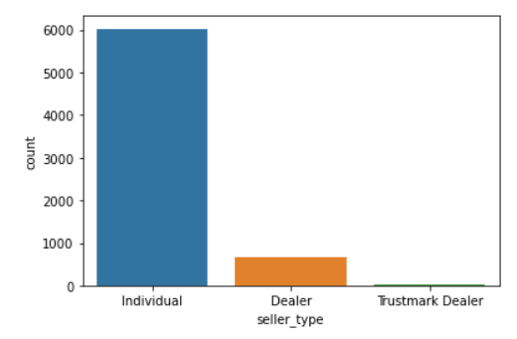
1. Seller Type
Using Count Plot :
We found that most of the sellers are individual

Slide 10
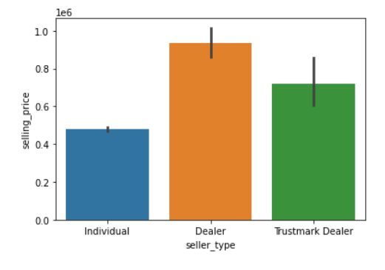
1. Seller Type
According to the selling_price:
Dealers can sell vehicles at a higher selling price than a general individual. No surprises at all !

Slide 11
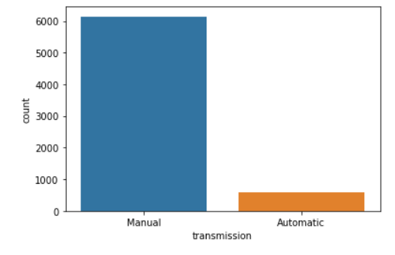
2.Transmission
Using Count Plot :
Most of vehicles are Manual transmission.

Slide 12
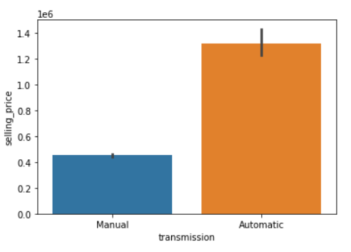
2.Transmission
The selling price for manual VS automatic vehicles:
automatic vehicles are found to have a large resale value in the market compared to manual transmission.

Slide 13
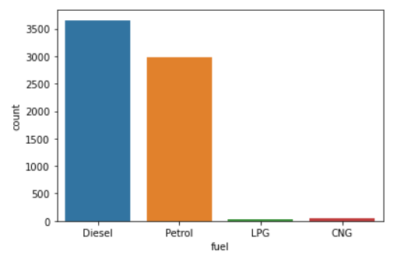
3. Fuel Type
Using Count Plot :
Most of vehicles are using Diesel fuel.

Slide 14
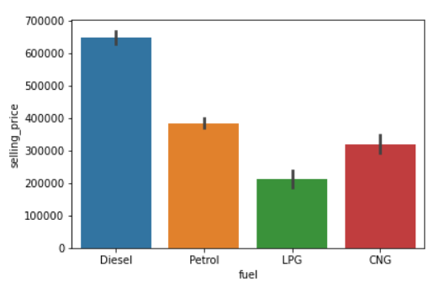
3. Fuel Type
The selling price based on different types of engine fuel:
Diesel Engine Vehicles are found to have the highest selling price amongst Petrol and CNG engine vehicles

Slide 15
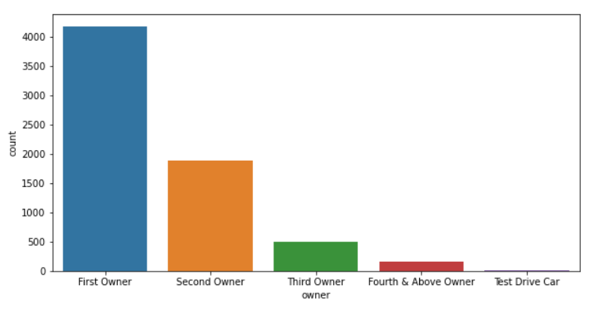
4. Owner Type
Using Count Plot :
Most of vehicles owners are first owner.

Slide 16
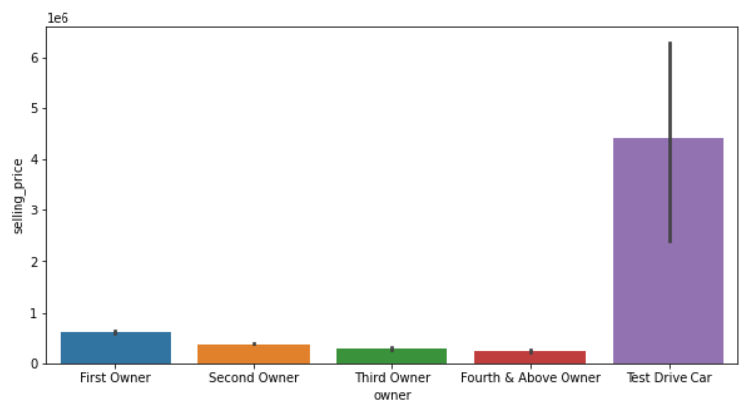
4. Owner Type
The selling price based on the type of owner:
the vehicles belonging to owner 0 have the highest selling price

Slide 17
Visualizing the relationship between Target Variable [Selling price] against Numerical Features:

Slide 18
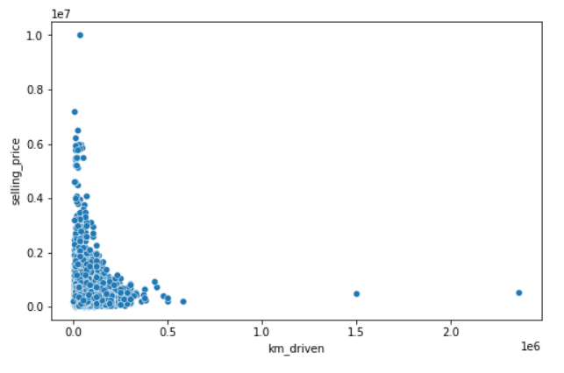
1. Kms Driven
The selling price is found to be higher for vehicles with less kms covered !

Slide 19
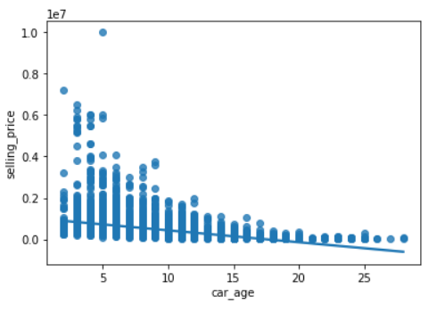
2. Car Age
It seems the selling price decreases overall for older/ageing vehicles!

Slide 20
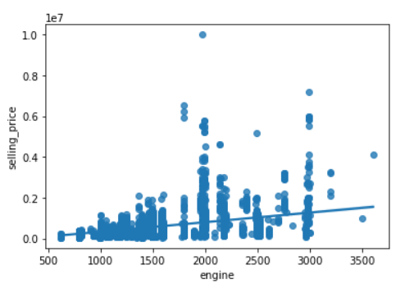
3. Engine
The selling price is found to be higher with vehicles with higher engine power!

Slide 21
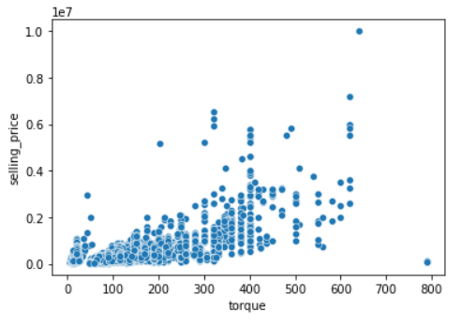
4. Torque
As the torque of the vehicles increases the selling price also increase!

Slide 22
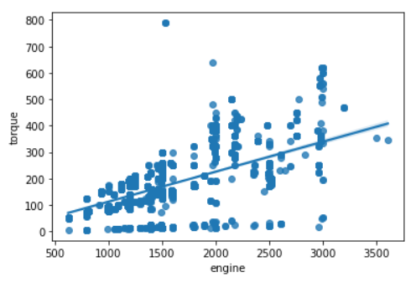
Relation between Engine and Torque
It seems that the correlation between the Torque and the engine is highly positive!

Slide 23
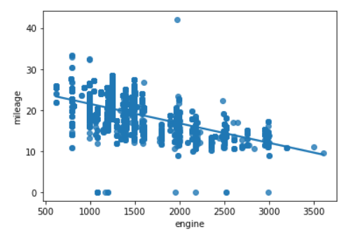
Relation between mileage and the engine
As the mileage of the vehicles decreases the engine power increases.

Slide 24
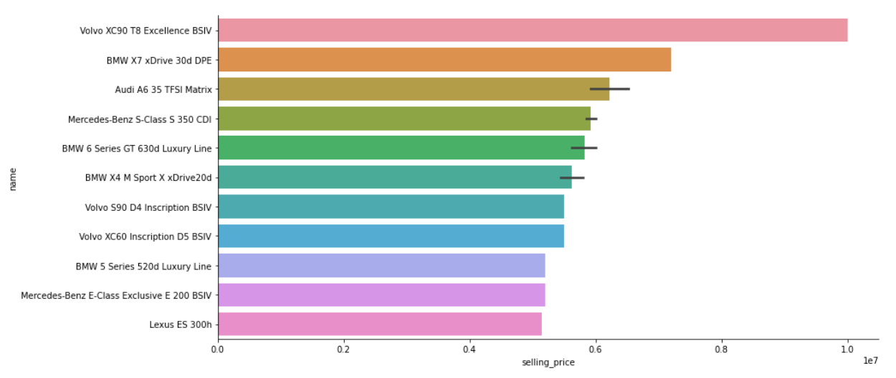
Top 20 vehicles have the highest selling price

Slide 25


TEAM:
Alaa Hussien
Alaa Ayman
THANK YOU

